Slide 1
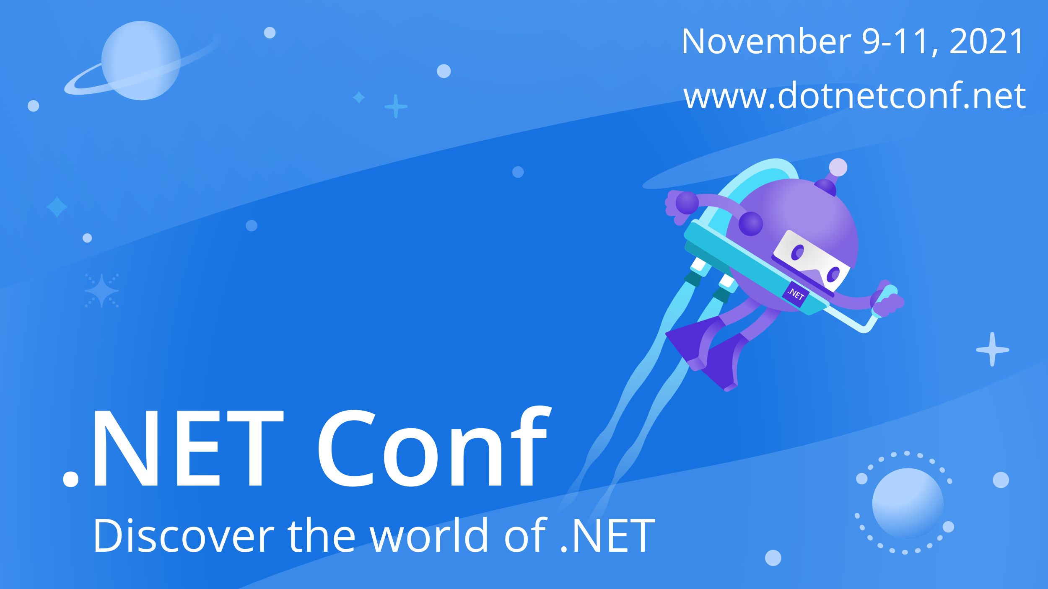

Slide 2


Power Up You Development with Power Apps and Power Automate
Matt Soucoup - @codemillmatt

Slide 3
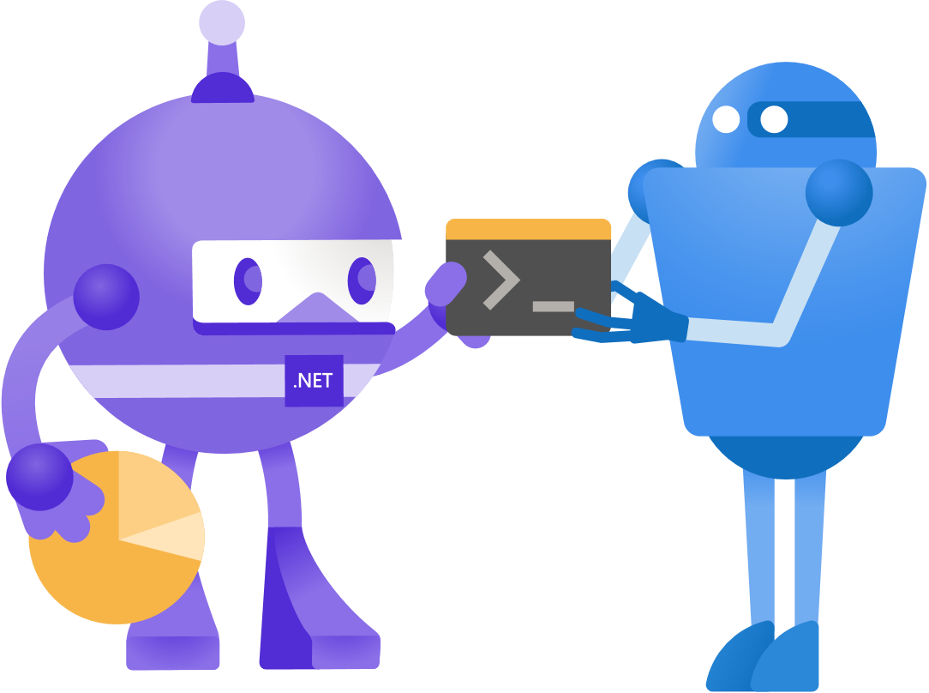
What is low-code development?
Solve complex business problems without writing a ton of code …
… but you still might write code
Power Apps
Power Automate
Power Virtual Agents
Azure Logic Apps

Slide 4
Do .NET devs need to know low-code?
Yep
Support business pros using low-code
Replace legacy systems
Automate everyday tasks
The connectors

Slide 5























The connectors

Slide 6

Demo
Make your life easier with Power Automate

Slide 7

Demo
Power Apps for ProDevs - Legacy app rewrites

Slide 8
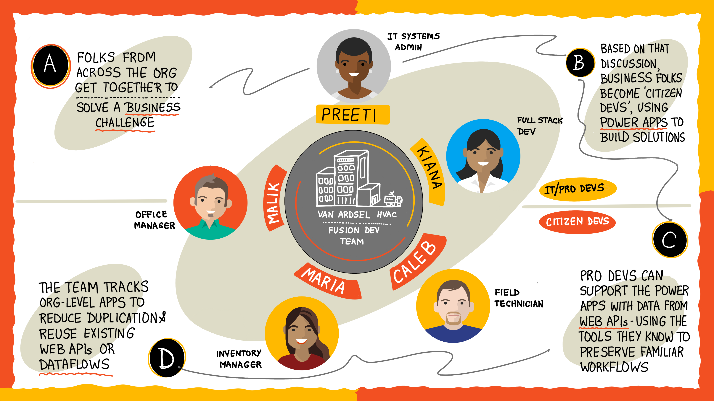
Fusion development

Slide 9
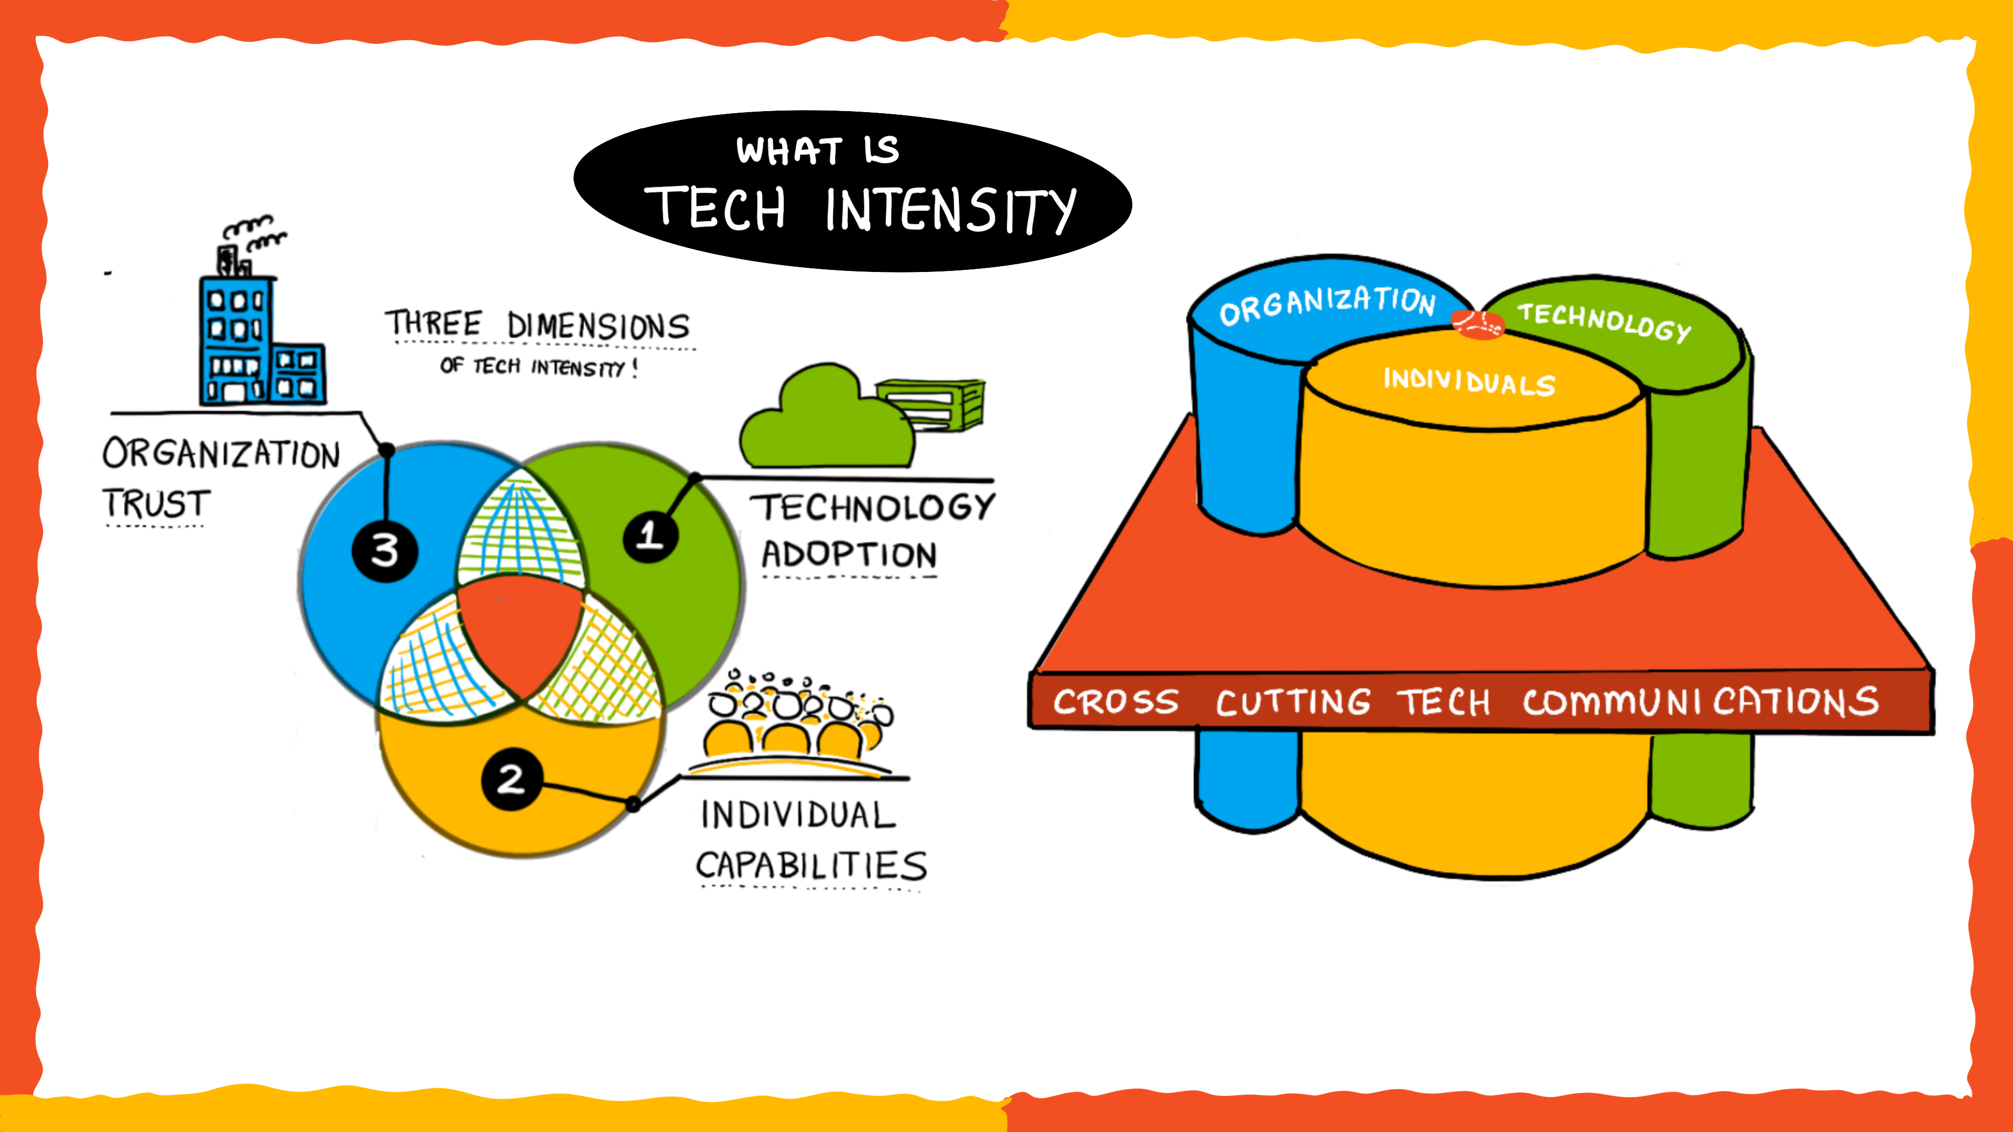
Fusion development

Slide 10
One high-code to low-code flow
Azure Functions
HTTP trigger
Deploy Azure Functions app
Deploy Azure API Management
Export to a custom connector
Deploy Azure API Management
Functions OpenAPI extension

Slide 11

Demo
Custom connectors with Azure Functions

Slide 12

Summary
Solve complex business problems without writing a ton of code … but you still write some.
Power Apps, Power Automate, Power Automate, Azure Function Apps
Automate everyday tasks
Replace legacy systems
Fusion development teams
Provide high-code services to low-code apps

Slide 13
Power Up You Development with Power Apps and Power Automate
Matt Soucoup - @codemillmatt

